Slide 1


Mini Project
Project Submission
Due Friday, june 27th at 1:00pm

Slide 2

PLAN
Problem
Methodology
Results
Proposed solution
References and appendices
Team members

Slide 3


Problem
Ayiti Analytics Data wants to expand its training centers throughout all the communes of the country.
Its objective is to know which three communes of the country will be the most likely to expand its training centers.

Slide 4
Stakeholders
Ayiti Analytics (the project)
Michel, as the owner is the first one impacted by this problem of losses. Business is made to generate profit to the owner so losses is not what is he was attended to.
If the father is affected this included that his son is also affected by the problem. The profit will be benefit for him too.
Ayiti Analytics (the staff)
If Michel chose to not sell tomato paste anymore it would affect them especially those who buy it. And if they are not buying the product it's because there's a problem somewhere.
The providers and all those who have participated in the supply chain (Bus driver…)
If Michel decided to stop purchasing the products, it would be non benefits for the provider.

Slide 5


Methodology
Firstly, we will collect data for the analysis. We will use the data related to the list of applications, to the communes, and to which channel the news were spread, to the people who have paid to be enrolled in the bootcamp, either by moncash or paypal/credit card

Slide 6


Methodology
Secondly, we will use Python to manipulate the data. We will start by treating the data and then we will look for the quantity of applicants by communes, who actually pay for the online course “ entwodiskyon nan syan done”, people who pay for the course how they heard about Ayiti Analytics

Slide 7


Methodology
And then, we will use mathematics and statistics tools such as average, sum, trends to make calculations based on the people who apply for the bootcamp and people who pay to be part of the next step, and with more.

Slide 8
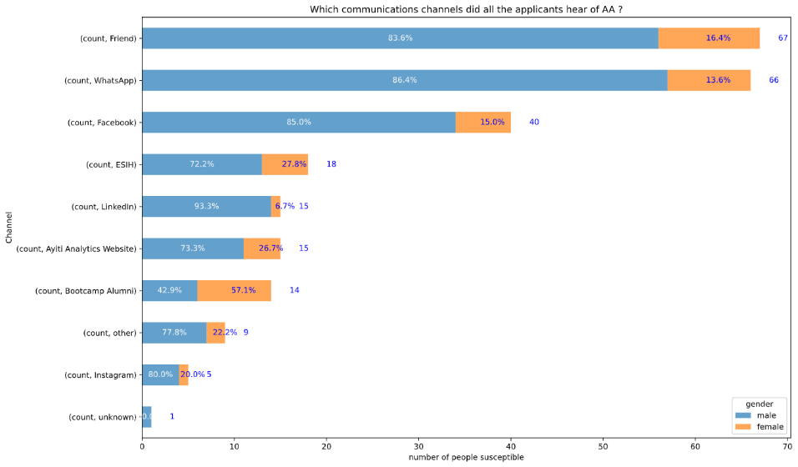
How all the applicants heard about Ayiti Analytic

Slide 9
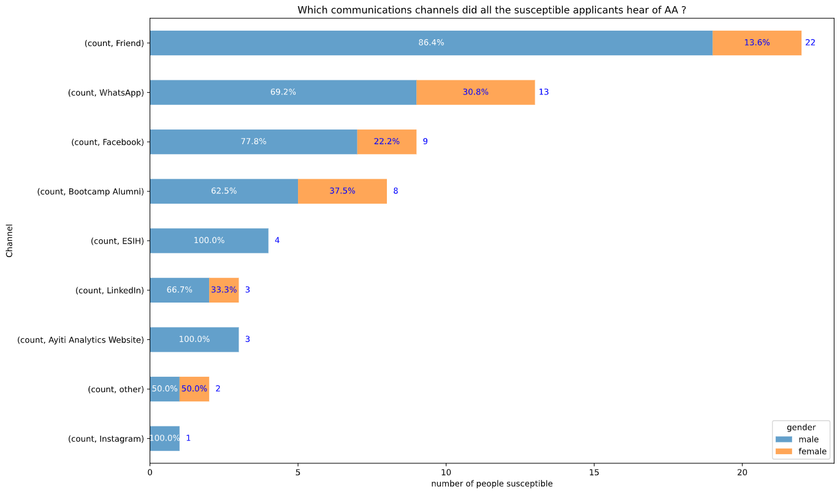
How people who susceptible to selection heard about Ayiti Analytics

Slide 10
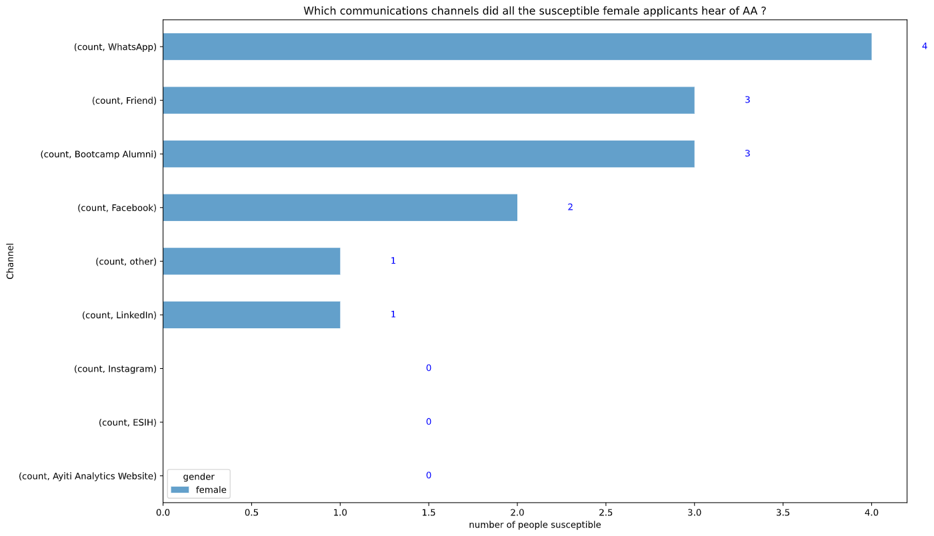
How female who are susceptible to selection heard about Ayiti Analytics

Slide 11
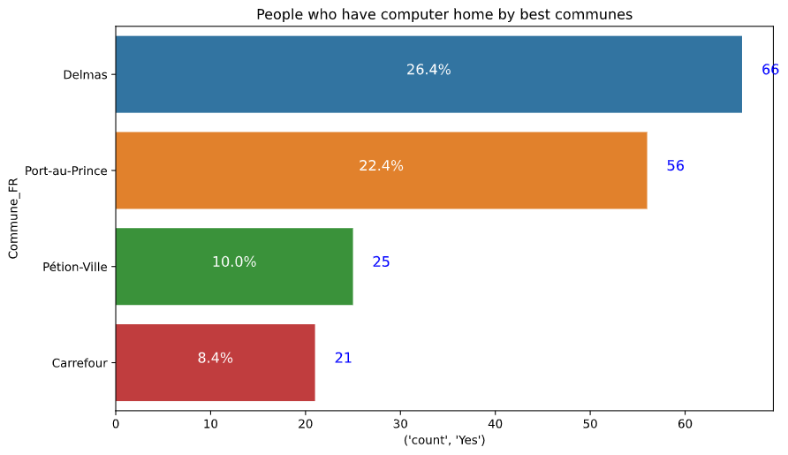
People who have computer by best communes
Beside of P au P , you can see delmas, petion ville, Carrefour, there are more people who have computer at their home

Slide 12
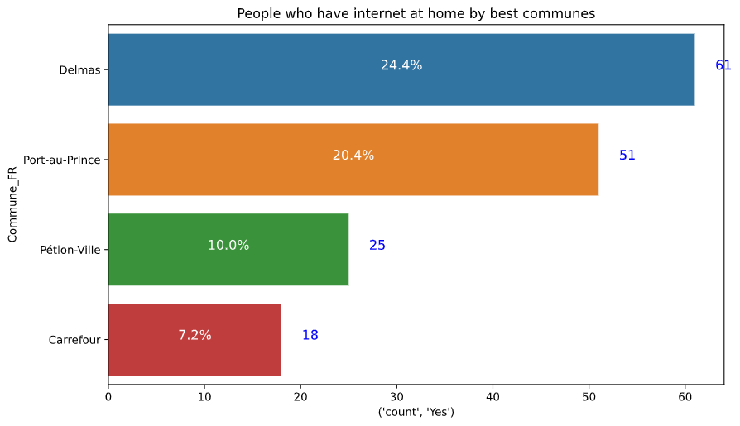

People who have internet by best communes
yu can see in petion ville in delmas in Carrefour, there are more people who have internet

Slide 13
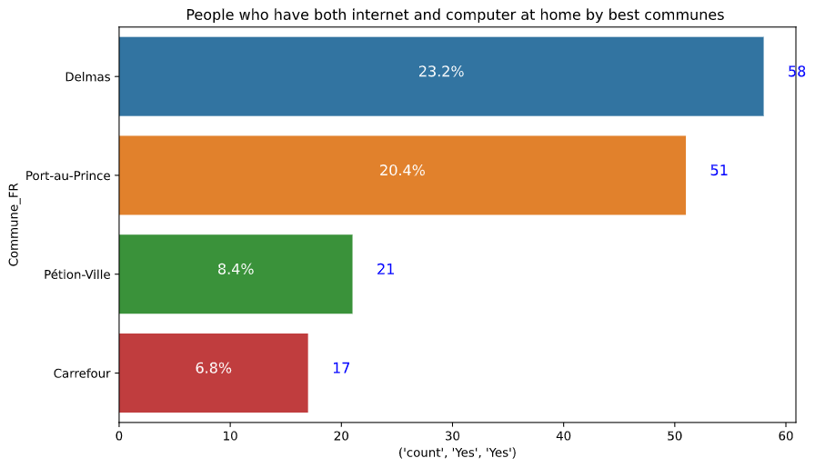

People who have both internet and computer by best commune
You can see that in delmas, petion ville, Carrefour, most applicants have both computer and laptop at the same time

Slide 14
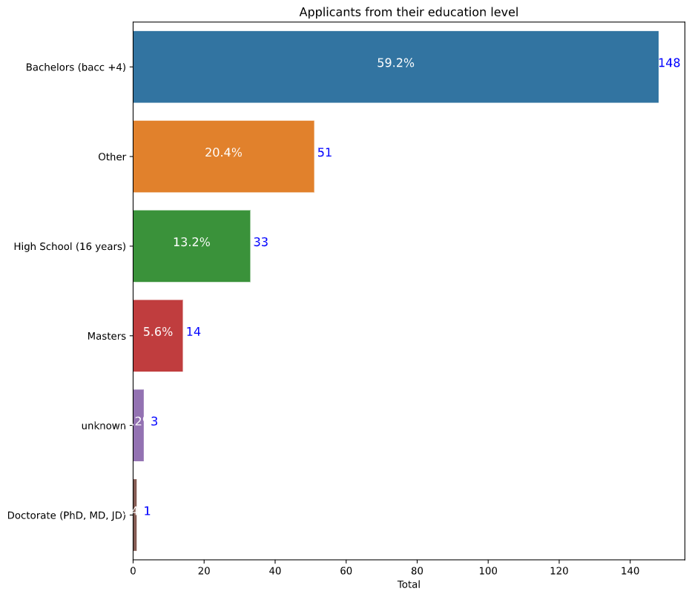
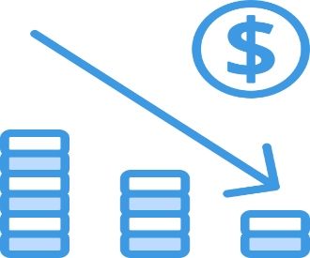
Applicants by education level
You can see that there are a lot people who apply in the bootcamp are in back+4

Slide 15
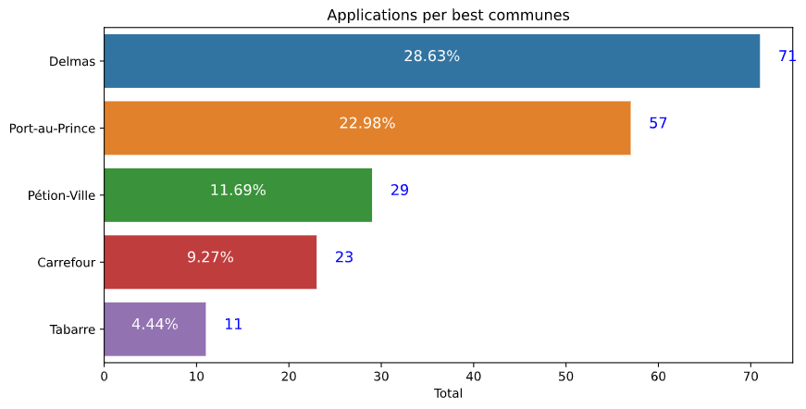
Applications by best communes
You can see that delmas , petion ville, Carrefour are the highest zone of applicants

Slide 16
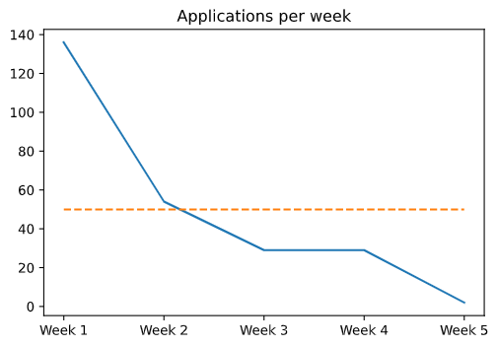
The flow of the people who apply by weeks
We can see that the number of applicants by week keep decreasing

Slide 17
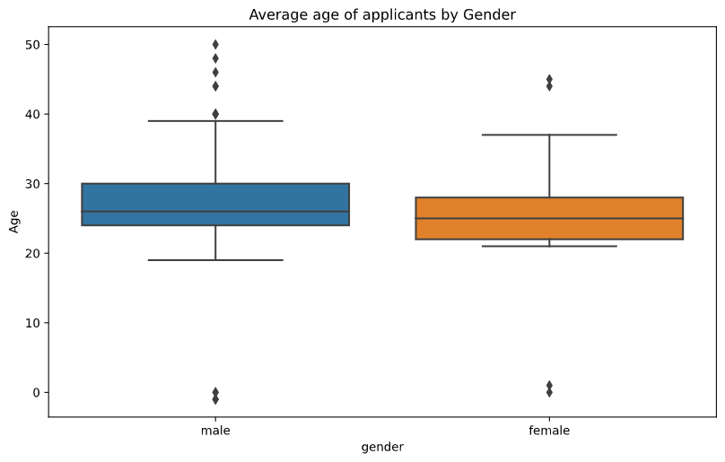
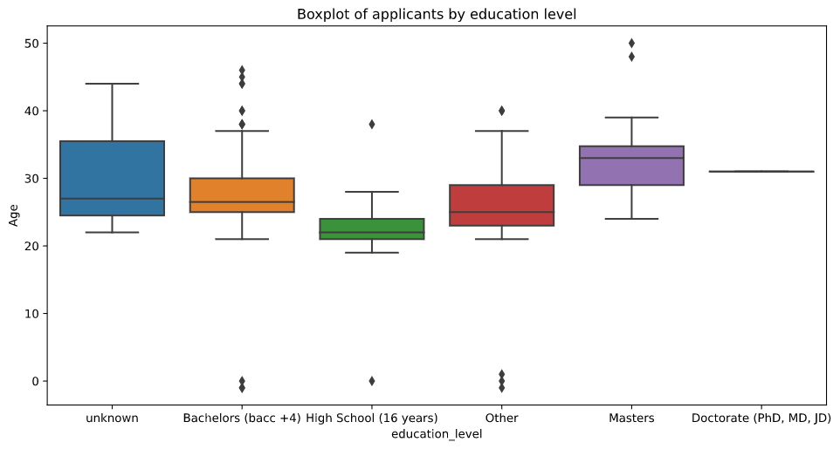
Quick overview in boxplot by Gender and education level

Slide 18
SWOT
Opportunities | Threats
Organize a market research based on a survey They can use the result of the business analysis to adjust their stock Adjust their business to the market trends | The waste of so many products A considerable loss The lack of business analysis Bankruptcy
Strengths | Weaknesses
Multiple brands Record of each transaction Stock on time | Problem of management The brands don’t really affect the customers Lack of information on the market

Slide 19
Discussion
The different graphics above shown the business situation of the store boutique. The amount spent by the owner is above the profits he made for the three months of record we studied. Which is very alarming. The boutique can’t make any real profit concerning the selling of tomato paste. To find a solution, the team questioned:
The frequency of orders
The quantity of boxes ordered
The policy regarding the offer

Slide 20
Proposed solution

Slide 21
References & Appendices
www.marketsandmarketsblog.com
What is Business Analysis? | Global Standard for Business Analysis Certification | IIBA®
Strength, Weakness, Opportunity, and Threat (SWOT) Analysis Definition (investopedia.com)

Slide 22


Presentation
Jeffking STERILE

